Slide 1
Introduction to Information Systems and Programming
Week 03 - S3

Slide 2
Today class
Review
Online quiz

Slide 3
Online quiz
socrative.com
Room: A1581342

Slide 4
Activity: what are printed? Hint: implicit “super”
1, 2, 3, 4
4, 2, 3, 1
4
None of the above
public class Faculty extends Employee {
public static void main(String[] args) {
new Faculty();
}
public Faculty() {
System.out.println("(4) Faculty's no-arg constructor is invoked");
}
}
class Employee extends Person {
public Employee() {
this("(2) Invoke Employee’s overloaded constructor");
System.out.println("(3) Employee's no-arg constructor is invoked");
}
public Employee(String s) {
System.out.println(s);
}
}
class Person {
public Person() {
System.out.println("(1) Person's no-arg constructor is invoked");
}
}

Slide 5
Activity
Any error in this program?
public class Apple extends Fruit {
}
class Fruit {
public Fruit(String name) {
System.out.println("Fruit's constructor is invoked");
}
}
Missing a no-arg constructor in class Apple
Missing a no-arg constructor in class Fruit
A and B
No error

Slide 6
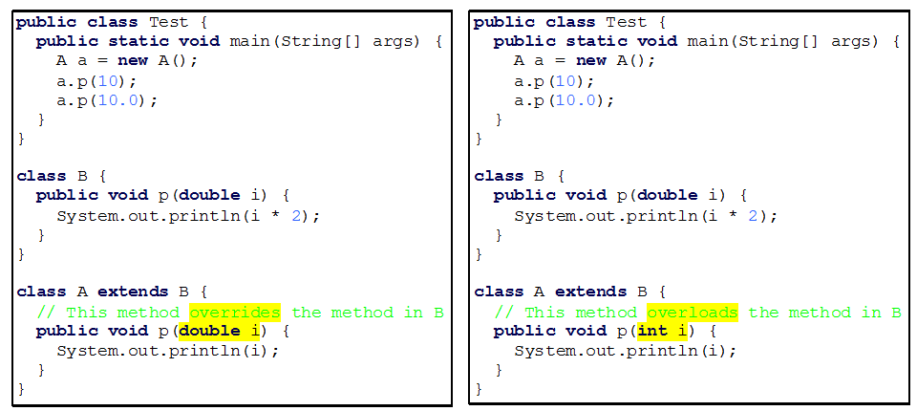
Overriding vs. Overloading

Slide 7
Overriding vs. Overloading
what are printed?
10.0, 10.0
10.0, 20.0

Slide 8
Overriding vs. Overloading
what are printed?
10, 10.0
10, 20.0

Slide 9
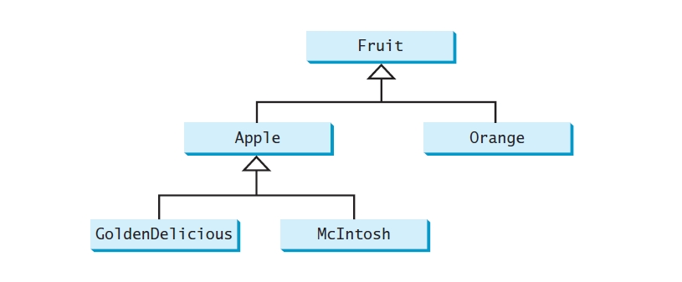


Activity

Slide 10
Activity
Fruit fruit = new GoldenDelicious();
fruit instanceof Fruit?
fruit instanceof Orange?
fruit instanceof Apple?
fruit instanceof GoldenDelicious?
fruit instanceof McIntosh?
T, F, T, T, F
T, T, F, F, F
F, F, F, F, F
T, T, T, T, T

